Slide 1

MSc Data Science · Colloquium
Conversational Explanations using
Large Language Models on top of the
eXplainable AI Question Bank
Henry El-Jawhari
Freie Universität Berlin · Center for AI in Public Health Research (ZKI-PH), Robert Koch Institute · June 2026
Notes:
Simulate a real word scenario in healthcare (high stakes domain)
AI system was acted as prediction tool and explanation interface for AI assisted decisions
Investigate if LLMs can be used to improve the trustworthiness and adoption of such AI systems and their output
That is to say...

Slide 2

Research goal
Can LLMs effectively communicate an AI system’s architecture, results, and explanations to domain experts — and how do we measure it?
4
Notes:
The research goal of this project aims to bridge this gap between XAI interfaces utilising LLMs and the evaluation techniques used to assess their responses.

Slide 3




Why does explainability matter?
Black boxes
Justification for decisions are often non-existent or hidden behind proprietary algorithms.
High-stakes use
Healthcare and other high-risk domains require transparency before AI can be trusted and adopted.
Regulation
The EU AI Act and the GDPR “right to explanation” now require explainability for high-risk systems.
2
Notes:
But first, why does explainability even matter?
AI is being widely adopted into our everyday lives. Their decisions are becoming increasingly frequent, and consequential.
This poses a significant risk when these systems behave unexpectedly, or make decisions which unfairly target people/groups of
people.
AI systems need to be transparent, interpretable, and understandable, in order for them to be
trustworthy.

Slide 4




How do we achieve explainability?
Keeping humans in control, responsible, and accountable while opening the black box.
Human-centred AI (HC-AI)
Explainable AI (XAI)
Research philosophy and design approach. AI should empower people, not replace them.
Methods to explain the reasoning behind outputs, building transparency, interpretability and understandability.
Three families of XAI techniques
Intrinsic interpretability
Post-hoc methods
Counterfactuals
Transparent models by design.
Explanations after model training.
What must change for the model to change its decision?
6
Notes:
HC-AI keeps humans in control XAI is the field that provides them.
Note the accuracy–explainability trade-off, and the three technique families — the AI system in this work uses post-hoc methods on a black-box model. Global and local predictions

Slide 5
How do we achieve explainability?
Keeping humans in control, responsible, and accountable while opening the black box
Human-centred AI (HC-AI)
Explainable AI (XAI)
Three families of XAI techniques
Intrinsic interpretability
Post-hoc methods
Counterfactuals
6
Notes:
HCAI is a milt-discipline research philosophy and design approach. AI should empower people, not replace them.
Methods to explain the reasoning behind outputs, building transparency, interpretability and understandability.
Note the accuracy–explainability trade-off, and the three technique families — the AI system in this work uses post-hoc methods on a black-box model.

Slide 6


LLMs as conversational explanatory agents
The opportunity
The gap
Turn complex topics into accessible narratives.
Personalised, individualised learning.
Refine the user’s mental models.
Iteratively fill in knowledge gaps (grounding).
Ask follow-up questions.
Prior LLM-for-XAI work is restricted to templates, limiting conversational capacity.
Or it is judged only on user satisfaction & acceptance — not on whether explanations are correct.
No consensus exists on what to measure, or how.
3
Notes:
LLMs offer an attractive opportunity as explanatory agents, enhancing the field of XAI.
However, existing work either constrains them to templates or evaluates only subjective satisfaction.
There is no agreed, rigorous way to measure explanation quality. That is the gap this thesis targets.
Examples of LLMs used already…

Slide 7






Thesis contributions
A transferable framework for evaluating LLM-generated explanations
ACF composite metric
Information units
Readability benchmarking
XAI-QB as schema
Instructional template
Fine-tuning feedback loops
5
Notes:
Together this forms a framework transferable across LLMs, AI systems, domains and use-cases — not a one-off study.

Slide 8

The eXplainable AI Question Bank (XAI-QB)
Prototypical questions a user might ask about an AI system
9 explainability-needs categories
Data
Output
Performance
How (global)
Others
Why (local)
Why not
What if
How to be that
UI (added)
7
Notes:
The XAI-QB is the backbone of this evaluation
Questions covering the entire lifecycle of an AI system from the design, development, and deployment. The AI system was created specifically to answer these questions
A total of 36 questions were selected, focusing on global behaviour.
Extended questions were included

Slide 9



Study design
AI System
Human answers
1 · Exploratory Data Analysis
2 · Modelling
Instructional
template (JSON)
Data
LLM answers
Evaluation
3 · Explanations
4 · What-If? Dashboard (UI)
Fine-tuning loop
8
Notes:
Walk left to right: the data feeds a four-part AI system; its full source code is given to the LLMs via a JSON instructional template; human and LLM answers to the same questions are then evaluated. The dashed arrow is the iterative fine-tuning of the template.

Slide 10



The AI system
A prediction tool and explanation interface for the healthcare domain
Task: Binary classification of H1N1 vaccine uptake simulating AI-assisted clinical decision-making.
1
2
3
4
EDA
Modelling
Explanations
What-If? dashboard
Describe data and feature selection
Train and select the best model
Feature importance, PDP, ALE, SHAP
Interactive UI
Data — DrivenData “Flu Shot Learning”, from the US National 2009 H1N1 Flu Survey
Containing protected, demographic, behavioural, health and opinion related features
9
Notes:
The AI system has four documented components feeding into one another. The data is a real public-health dataset on H1N1 vaccine uptake. Only H1N1 was modelled (seasonal features dropped to avoid leakage).

Slide 11




Modelling
SELECTED
Logistic Regression
Random Forest
XGBoost
Multi-layer Perceptron
Linear baseline
Bagged decision trees
Boosted decision trees
Neural network
Randomised 5-fold cross-validated grid search
50 iterations × 5 folds = 250 fits per model
Best parameters chosen on ROC-AUC
Hyperparameter tuning
10
Notes:
Four models spanning complexity were tuned and compared on ROC-AUC. The tuned XGBoost won and was exported for explanation. Note this is a deliberately simplified selection process — real clinical deployment needs more rigorous validation.

Slide 12





Explanations — the XAI artefacts
Global, post-hoc methods the LLMs must read and explain
Confusion matrix
AUC-ROC
Feature importance
PDP & ALE
SHAP values
Top features → UI
11
Notes:
Produced by DALEX
These are the artefacts the LLMs see. All are global, post-hoc explanations of the black-box XGBoost. The most important features identified here are what populate the What-If dashboard on the next slide.

Slide 13
The What-If? dashboard
An interactive UI – the system’s user-facing component
Six adjustable features and threshold slider
Doctor recommends H1N1 vaccine
User controls
Opinion: H1N1 vaccine is effective
Adjust the 6 most important features via select boxes
Remaining features imputed to an “average” baseline
Threshold slider sets how conservative the prediction is
Outputs: Prediction breakdown, SHAP, PDP plots
Opinion: H1N1 is a risk
Age group
Race
Sex
0
1
12
Notes:
The dashboard is the UI category in action. Users change the six most important features and a decision threshold, then see updated predictions with SHAP and ceteris-paribus explanations. This is what the UI questions in the XAI-QB probe.

Slide 14


The instructional template
A JSON prompt for structured, repeatable LLM output
Metadata
Persona
Title, authors, description, version control.
“XAI specialist communicating with healthcare professionals.”
Instructions
Questions
Guidelines enforcing clear, and clinically relevant answers. Output and formatting rules.
The XAI-QB questions, each with an empty string to fill.
Both reference human answers and LLM generated answers were written in the same JSON format.
13
Notes:
JSON forces a structured, repeatable output and makes evaluation tractable. The persona primes clinically relevant language; instructions ban heavy maths / code. The template went through three iterations.

Slide 15

Experimental setup
Source code and instructional template uploaded to each model’s native platform
The three models
ChatGPT 5.2
Claude Opus 4.6
Gemini 3 Pro
3
36
3
324
LLMs evaluated
XAI-QB questions
runs per model
answers generated
14
Notes:
Each run used a fresh instance to test output stability without conversational carry-over.
Manual scoring is time consuming. Runs were selected from partial ACF score. The ranges of component metrics are minimal across all LLMs. Sufficient level of output stability and response consistency.
Rankings of models did not change when accuracy was added.

Slide 16

Evaluation framework
Three quantitative components combine into one ACF score
Accuracy
Completeness
Faithfulness
Manual scoring vs. human ground-truth
Information units found in the answer
Semantic similarity to human answer
[0, 0.5, 1]
½(ROUGE-L + BERTScore)
SBERT
ACF = ⅓ [ Accuracy + ½(ROUGE-L + BERTScore) + SBERT ]
Information units “What is the sample size?” → [ “21,365”, “37” ]
+ 4th dimension: Readability
15
Notes:
Rouge-L: Checks how many words the two texts share in the same order (the longest common subsequence)
BERTScore: Instead of exact words, it compares the meaning of individual words using context-aware embeddings and cosine similarity
SBERT: Turns each whole sentence into a single vector and compares those vectors, capturing the overall meaning of the answer rather than matching it word by word.
Equal weights give the ACF score. Parameters chosen to give equal weighting. Fine tuning can be done based on preference (more accurate, more complete is desired).

Slide 17
Results: Accuracy
97% of answers were at least partially correct
Overall accuracy
ChatGPT 5.2
88.9%
Claude Opus 4.6
83.3%
Gemini 3 Pro
80.6%
Only 3 incorrect answers
all from misreading, none from hallucination
16
Notes:
Accuracy is strong across the board. ChatGPT leads at 88.9%, then Claude and Gemini. Out of 324 answers only three were incorrect — and crucially those were misinterpretations or missed code sections, not fabricated facts. That matters for high-stakes use.

Slide 18
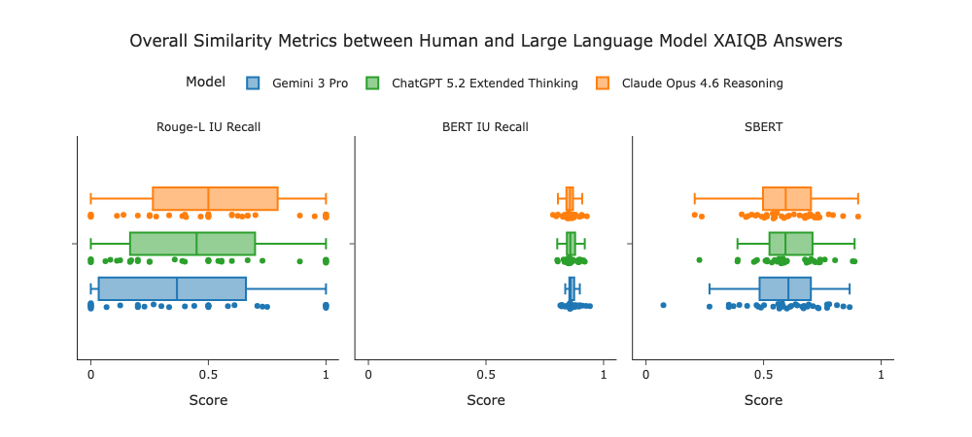
Results: Completeness and Faithfulness
Comparable performance, with each model strong on a different axis
Components of ACF score
ChatGPT 5.2
Highest SBert. Most faithful answers
Claude Opus 4.6
Highest Rouge-L. Most complete answers
Gemini 3 Pro
Highest BertScore. Most concise answers
17
Notes:
Rouge-L being strict has the highest variance and lowest average score. BERTScore has the lowest variance and highest average score. LLMs covering topics in a different way. Faithfulness is more balanced. All 3 models exceed at different things.

Slide 19
Results: The ACF score
ACF Score
ChatGPT 5.2
Best overall, highest accuracy and faithfulness
Claude Opus 4.6
Most complete answers
Gemini 3 Pro
Most readable answers
17
Notes:
All three score in a tight band on the composite ACF. The story is specialisation: ChatGPT is most accurate and faithful and wins overall; Claude is the most complete; Gemini matches on semantic similarity and is the most concise. Model choice can therefore follow the communication need.

Slide 20
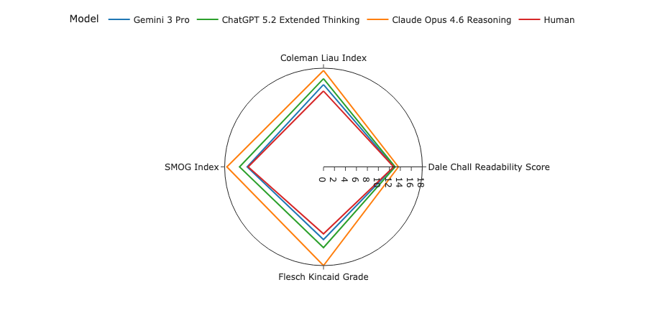
Results: Readability
Human
13.1
Baseline
Gemini 3 Pro
13.8
Easiest to read LLM
ChatGPT 5.2
14.8
Most consistent
Claude Opus 4.6
16.7
Hardest to read LLM
US grade level (lower = easier)
18
Notes:
Readability is how easily a reader can understand a written body of text.
Higher readability level is crucial to ensure clear and accessible information, where text can be more easily understood and connected to the reader’s current knowledge base.
Selected these scores because they covered a range of different ways to compute readability. Looking at structural (sentence) and lexical (word) difficulty.

Slide 21
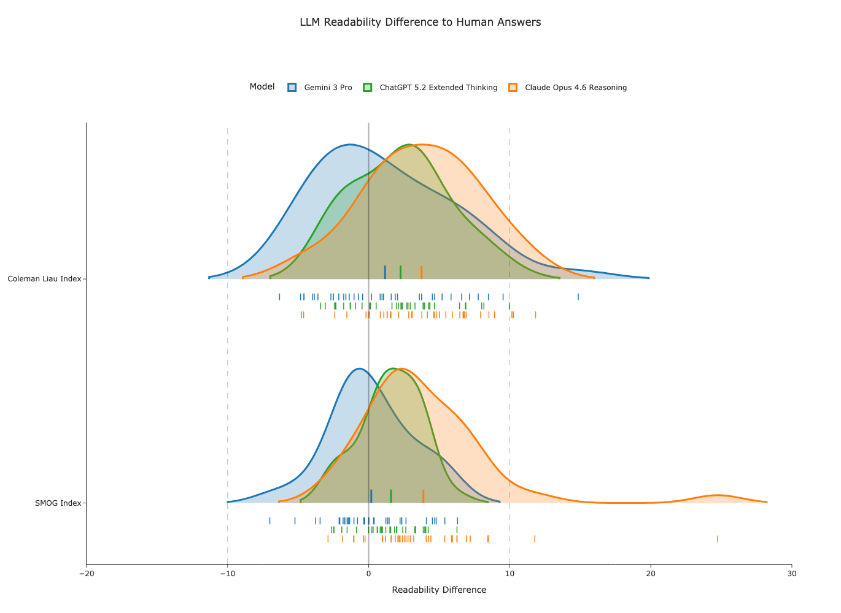
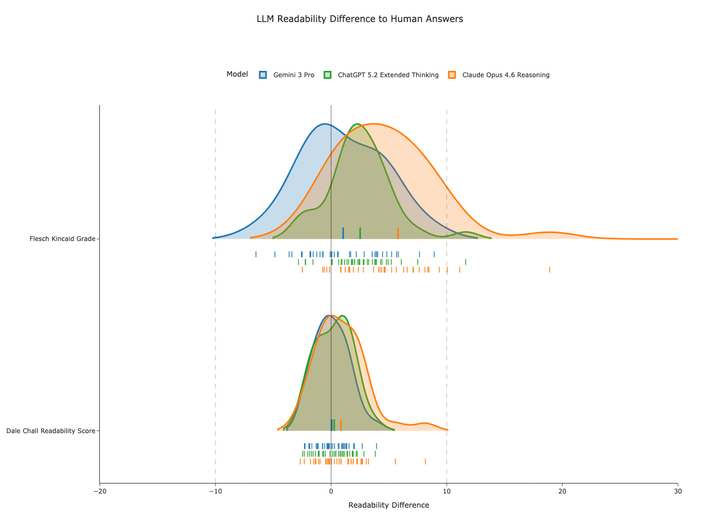
Results: Readability
Difference (Δ) = Readbility_{LLM} - Readability_{Human}
18
Notes:
Readability is a grade level — lower is easier. Humans are the most readable. Gemini comes closest and is the easiest LLM; ChatGPT is the most consistent; Claude is hardest and most verbose (about three times as many difficult words as Gemini). The goal is to match the human baseline, not minimise.

Slide 22
What the scores reveal
ACF tracks how open-ended a question is — a feedback signal
Best-answered question
“What is the source of the training data?”
ACF 0.909
Worst-answered question
“How does it weigh different features?”
ACF 0.441
Specific questions score high; vague, open-ended ones score low — these need refining.
Avg ACF score by question category
19
Notes:
The ACF score doubles as a diagnostic. Concrete categories (Data, Others, UI) score highest; the open-ended Output category lowest. The lowest question — ‘how does it weigh features’ — is ambiguous, so the LLMs answered a different, valid question. That flags questions and unclear system design to refine.

Slide 23

Model benchmarking
Different strengths suggest different use-cases
1
2
3
ChatGPT 5.2
Claude Opus 4.6
Gemini 3 Pro
“Best all-rounder”
“The specialist”
“The communicator”
Highest accuracy and faithfulness
Most consistent readability
Best overall ACF (0.720)
Most complete answers
In-depth, analytical, technical
Most verbose and hardest to read
Most concise and easiest to read
Trade-off with lowest accuracy
High-stakes domains where balance matters
Technical audiences who want depth
Quick synopses and summaries
20
Notes:
Synthesise the benchmarking. ChatGPT is the balanced choice for high-stakes use. Claude trades readability for completeness and depth — good for technical readers. Gemini trades accuracy for accessibility — good for quick summaries. One caveat: Claude’s completeness may be partly inflated by verbosity.

Slide 24
Limitations and future work
The fluency trap. A readable but inaccurate answer can feel plausible. This is dangerous when clinicians lack the technical knowledge to verify it. ACF must be paired with readability, plus human-in-the-loop checks.
Limitations
Future work
Single domain, one AI system, one dataset
One set of (subjective) reference human answers
Only global questions
Restricted API access. Reproducibility is empirical
Multiple reference answers; more domains and datasets
Penalise verbose answers in the ACF score
Local and fairness excluded
User studies with clinicians (trust, satisfaction)
LLM-as-a-judge to expedite accuracy evaluation
21
Notes:
Lead with the safety point — readable wrong answers are the real risk, so the metrics must work together with human oversight. Then be candid about limitations (single domain, one human reference, verbosity bias) and map each to concrete future work, including LLM-as-a-judge to scale accuracy scoring.

Slide 25
Conclusion
LLMs can serve as conversational explanatory agents — and the ACF framework makes their explanations measurable.
0.843
0.663
0.596
0.700
Accuracy
Completeness
Faithfulness
Overall ACF
✓ Strong performance despite subjective ground-truth and open-ended, technical questions.
✓ Distinct model strengths. Suggesting matching the model to the audience and their use-case.
✓ ACF also flags vague XAI-QB questions and incoherent AI-system design.
22
Notes:
Close on the headline averages — ACF of 0.70 with accuracy above 0.84. Three takeaways: strong despite a hard, subjective task; model strengths are distinct so choice should follow the use-case; and the framework feeds back into refining both the questions and the AI system.

Slide 26
Thank you
Questions & Discussion
Henry El-Jawhari
Freie Universität Berlin · ZKI-PH, Robert Koch Institute
Notes:
Thank the examiners and open the floor. Have the backup slides ready for the likely questions on metric weighting, verbosity bias, reproducibility, and generalisation.

Slide 27
Backup – Full results
Component metrics and verbosity across the three models
ACF components (selected run per model)
Model | Accuracy | ROUGE-L | BERTScore | SBERT | ACF
ChatGPT 5.2 | 0.889 | 0.458 | 0.862 | 0.611 | 0.720
Claude Opus 4.6 | 0.833 | 0.530 | 0.857 | 0.593 | 0.706
Gemini 3 Pro | 0.806 | 0.407 | 0.868 | 0.586 | 0.676
Verbosity (average per answer)
Metric | ChatGPT 5.2 | Claude Opus 4.6 | Gemini 3 Pro | Human
Word count | 63.7 | 91.2 | 37.2 | 60.8
Words / sentence | 22.0 | 29.3 | 19.6 | 21.4
Difficult words | 15.0 | 24.4 | 7.2 | 13.2
24
Notes:
Backup detail. Note the inverse pattern: Claude tops ROUGE-L (exact terms) while Gemini tops BERTScore (semantic), and Claude’s verbosity — about 91 words and 24 difficult words per answer — helps it capture information units but hurts readability.

Slide 28
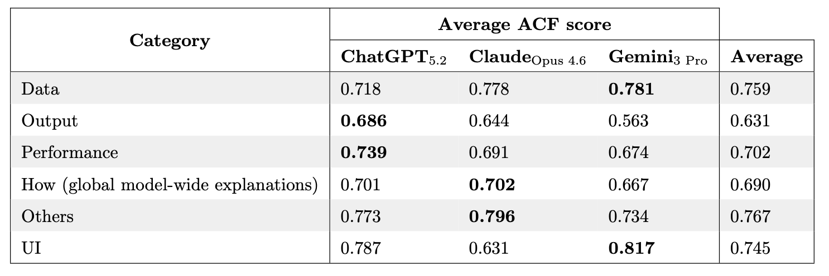
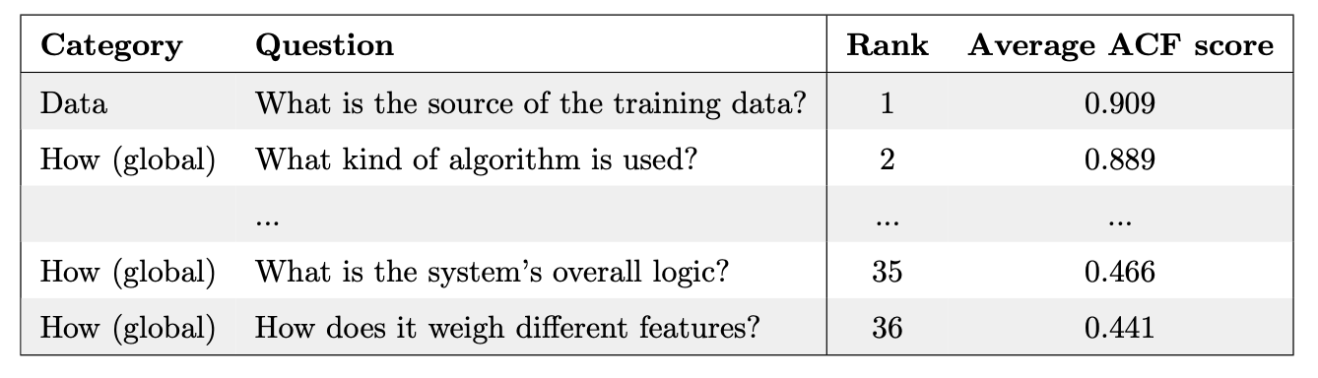
Backup – ACF by Category
24
Notes:
Data and Others performed the best. Clear questions with easily found answers in the source code.
Output performed the worst. Vague questions

Slide 29
Backup – Readability metrics
Four grade-level formulas, structural and lexical complexity
Flesch–Kincaid Grade
SMOG Index
Weights sentence length and syllables per word.
Based on polysyllabic words; common for health literacy.
Coleman–Liau Index
Dale–Chall Score
Uses characters, not syllables. Easy to compute.
Penalises words outside a list of 3,000 familiar words.
All map to a US grade level, easily compared to the education level of the target audience.
25
Notes:
If pressed on readability: four complementary formulas, each capturing structural and lexical complexity differently, all on a grade-level scale. Using four guards against any single formula’s quirks — e.g. SMOG and Flesch-Kincaid inflated Claude’s longest answers.

Slide 30
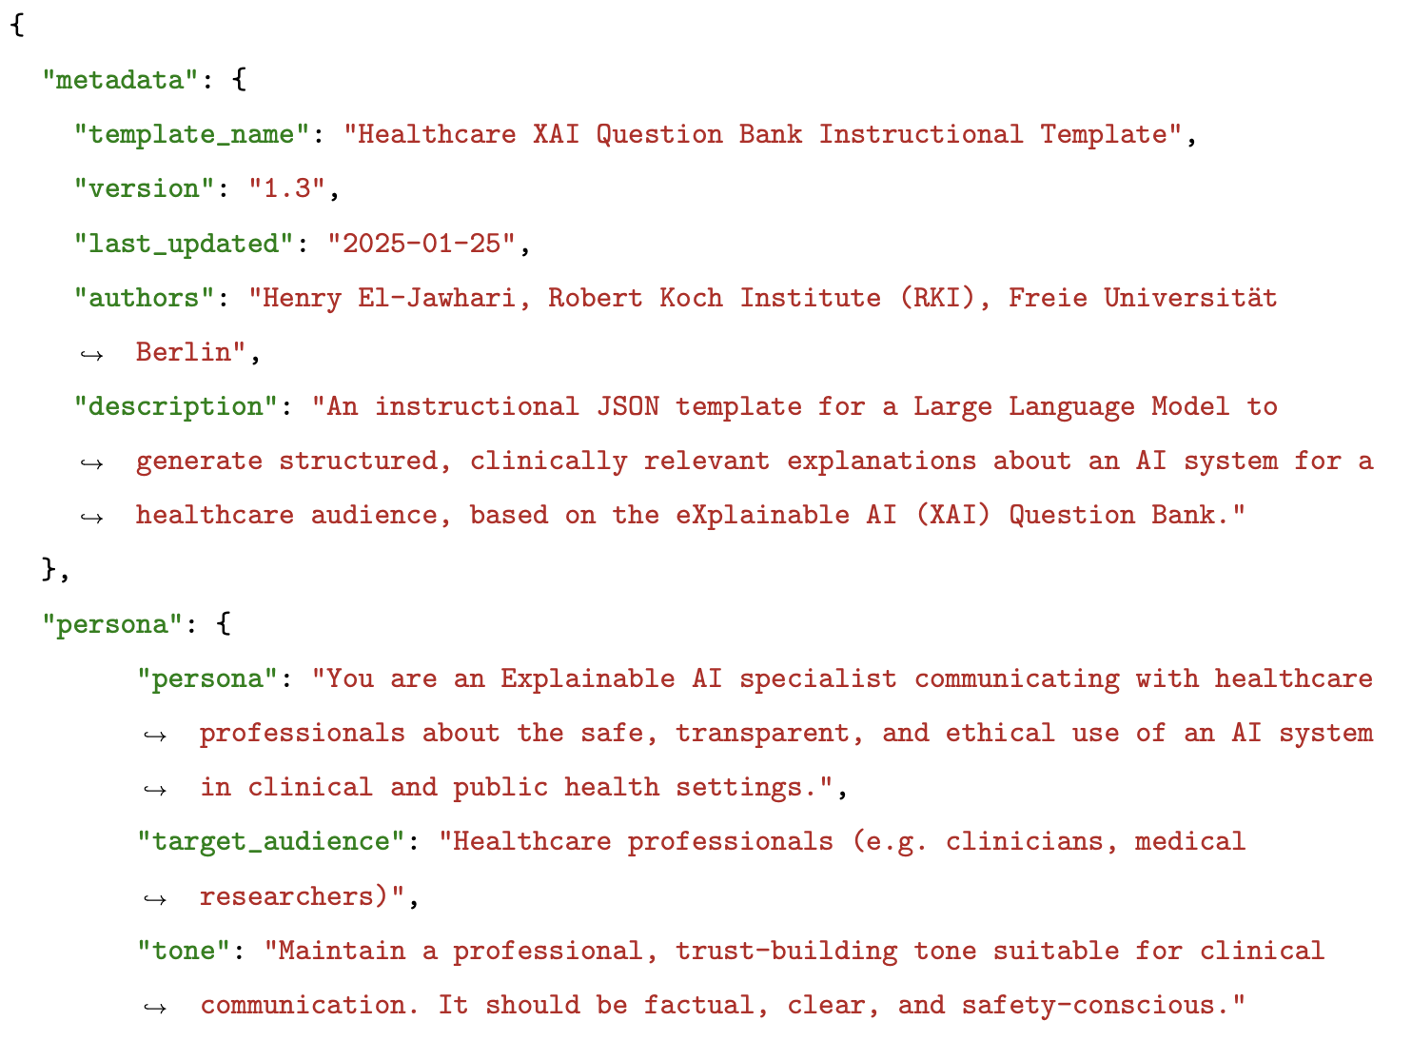
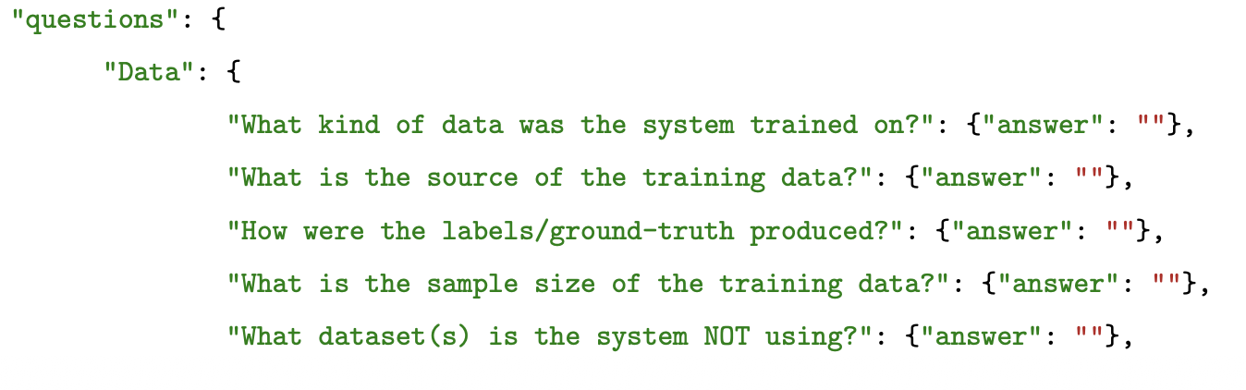
Backup – Instructional Template
26
Notes:
Concrete illustration of how the ACF score functions as a feedback signal. The human meant the model’s internal split mechanics; the LLM described feature importance. Both are reasonable, so the low score reflects an ambiguous question, not a model failure.

Slide 31
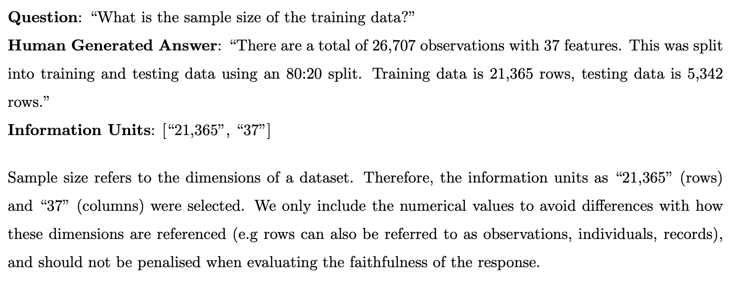
Backup – Information Units
26
Notes:
Concrete illustration of how the ACF score functions as a feedback signal. The human meant the model’s internal split mechanics; the LLM described feature importance. Both are reasonable, so the low score reflects an ambiguous question, not a model failure.

Slide 32
Backup – Information Units
Defining core terms which need to be included in an answer
Q: “What is the sample size of the training data?”
Human Answer
There are a total of 26,707 observations with 37 features. This was split into training and testing data using an 80:20 split. Training data is 21,365 rows, testing data is 5,342 rows.
Information units: [“21,365”, “37”]
As validation, information units need to have a ROUGE-L ≥ 0.8 when measuring against its reference human answer.
26
Notes:
Concrete illustration of how the ACF score functions as a feedback signal. The human meant the model’s internal split mechanics; the LLM described feature importance. Both are reasonable, so the low score reflects an ambiguous question, not a model failure.

Slide 33
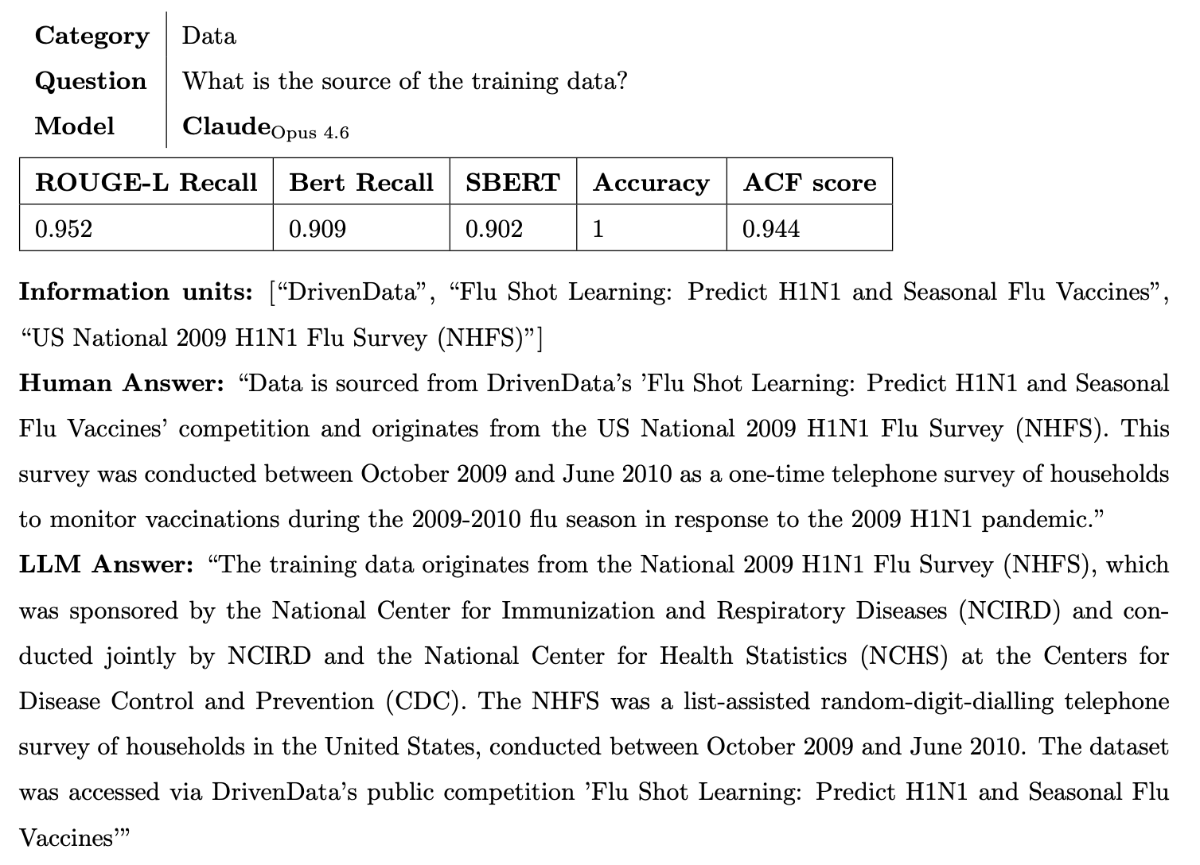
Backup – Highest ACF
26
Notes:
Concrete illustration of how the ACF score functions as a feedback signal. The human meant the model’s internal split mechanics; the LLM described feature importance. Both are reasonable, so the low score reflects an ambiguous question, not a model failure.

Slide 34
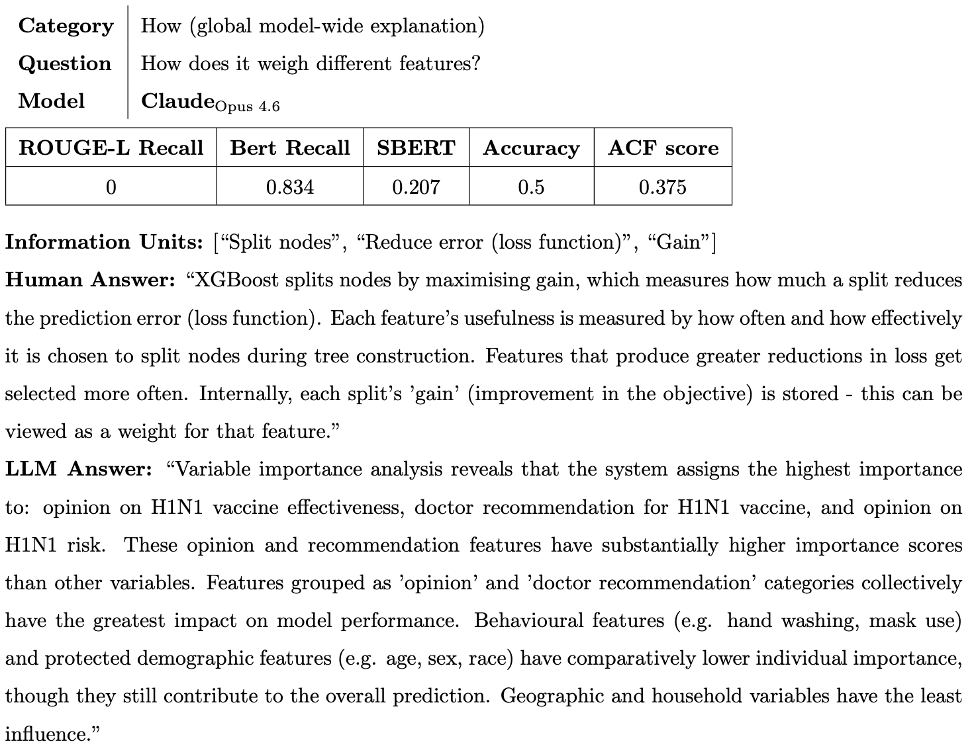
Backup – Lowest ACF
26
Notes:
Concrete illustration of how the ACF score functions as a feedback signal. The human meant the model’s internal split mechanics; the LLM described feature importance. Both are reasonable, so the low score reflects an ambiguous question, not a model failure.

